Slide 1
Mini Meco Introduction
Dirk Riehle, Univ. Erlangen
ADAP A01
Licensed under CC BY 4.0 International

Slide 2
Agenda
Mini Meco
Current state
Goal state
Homework

Slide 3
1. Mini Meco

Slide 4
Mini Meco Vision
Mini Meco is a web app to support our project based teaching

Slide 5
Base Design
Mini Meco is a web app to support our project based teaching
An admin (professor) can create courses (by semester)
Courses have an associated schedule (homework delivery dates)
Regular users (students) can create projects and add them to courses
A project can have one or more members (ADAP = 1, AMOS = 6..12)
A project is linked to exactly one GitHub repository

Slide 6
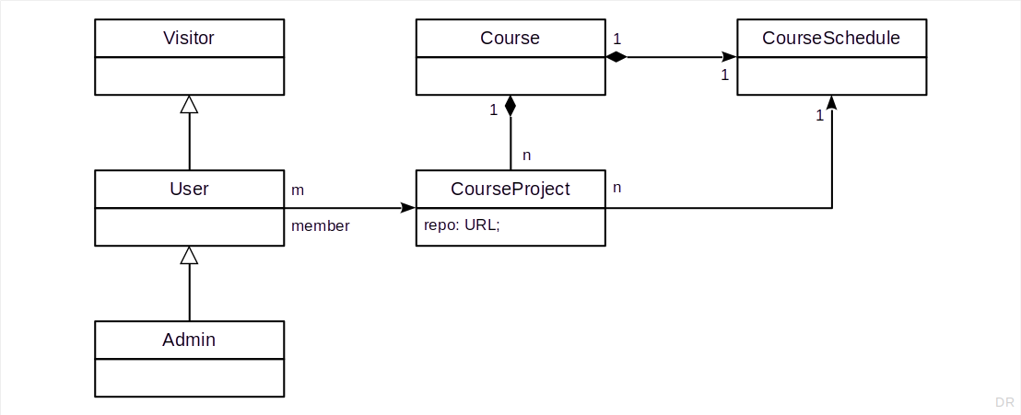
Class Model

Slide 7
Core Functions
For a given project, a member
Can send out stand-up emails
Can enter their happiness (index value)
Can review coding activities on GitHub
all scoped by the course schedule

Slide 8
2. Current State

Slide 9
Starting Mini Meco
Assuming the user role
Delete server/myDatabase.db
Start frontend and backend
Create new user via signup
Update status to confirmed using DB Browser
Logout, login (double-click needed)

Slide 10
Course Setup
Assuming the administrator role, on project admin screen
In project group list section
Create new semester
Create new course (= project group)
Click create twice
In project lists section
Enter course
Create new project
Click create twice

Slide 11
Joining a Project
Assuming the user role, under configuration
In the settings section
Select a course
Join a project by clicking on +
Enter your role (you can invent something)
In the project config section (optional)
Select a project that you are a member of
Provide a GitHub repository address

Slide 12
Using Functions
Assuming the user role
Select a project
Write stand-ups
Provide happiness
Review code activity (not working)

Slide 13
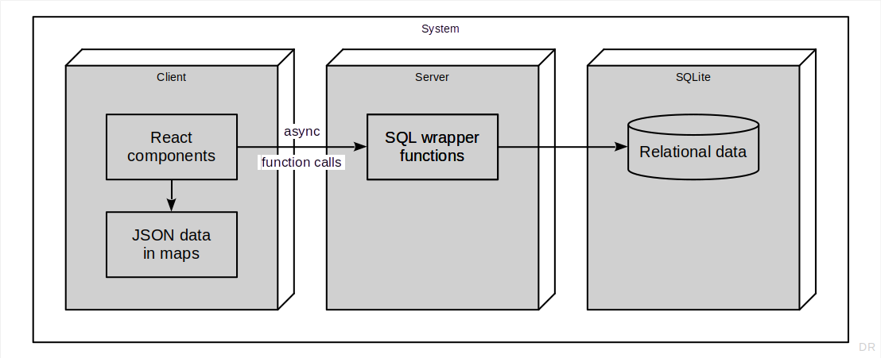
Current Mini Meco Architecture

Slide 14
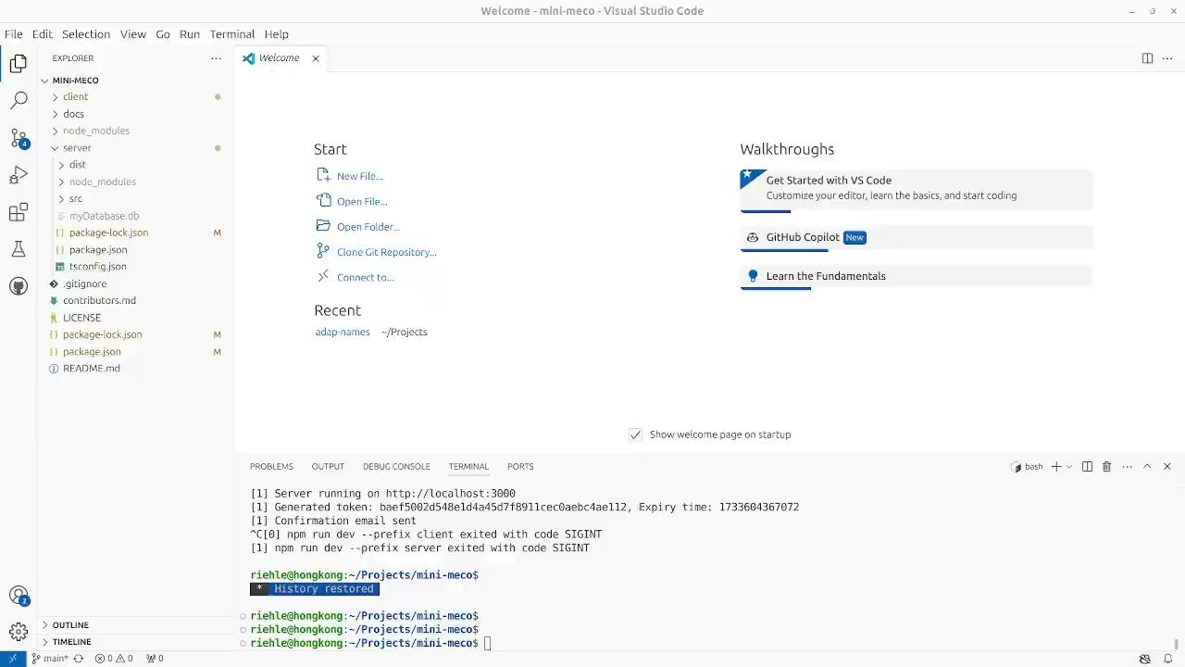
Video Demonstration
[1] https://drive.google.com/file/d/12oZK1FjUqV5--e3zzclMKsKecgO9_Tc_/view?usp=drive_link

Slide 15
3. Goal State

Slide 16
Project Mission
Learn how to refactor an application in need of improving

Slide 17
Goal State Overview
Create domain model
Use class model from before
Introduce proper value types
Fix user interface (still React)
Fix logical structure of UI
Connect to domain model
Map to database (still SQLite)
Fix database schema
Use serializer pattern

Slide 18
Class Model (Recap)

Slide 19
(Potential) Value Types
User name, password
User life-cycle status (probably enums)
Access rights
Happiness value (-3..0..3)
Timestamp, time, date, week, calendar year, semester, academic year
Commit
URL

Slide 20
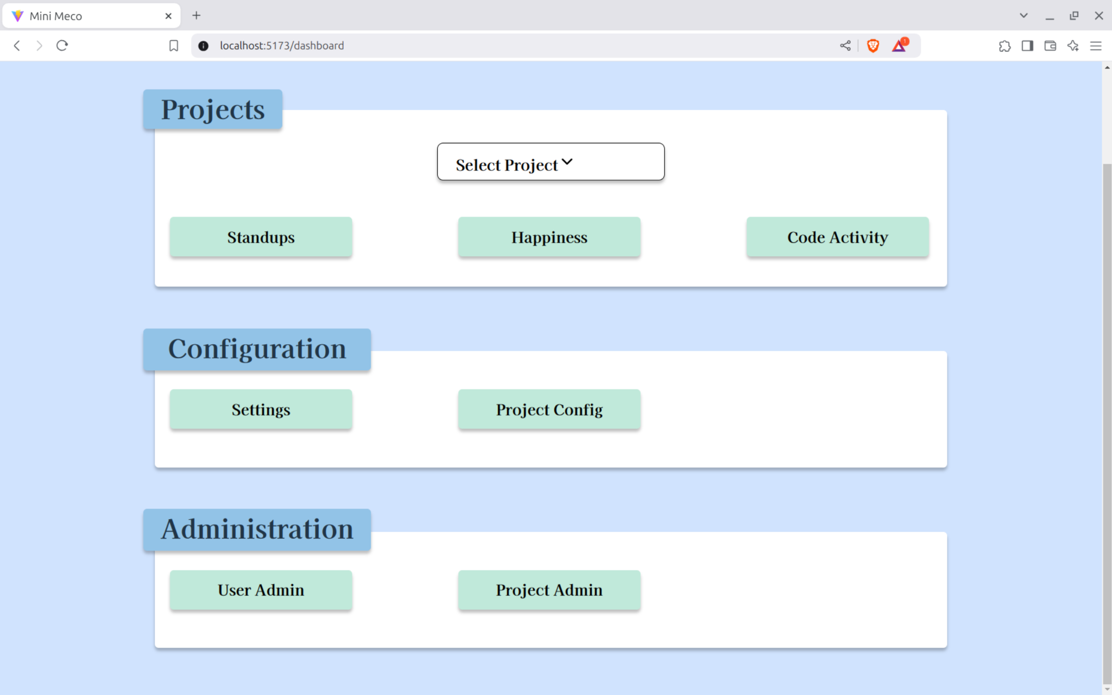
Dashboard
Courses and Projects
Join Course
View / Edit Project
System Administration
Manage Courses

Slide 21
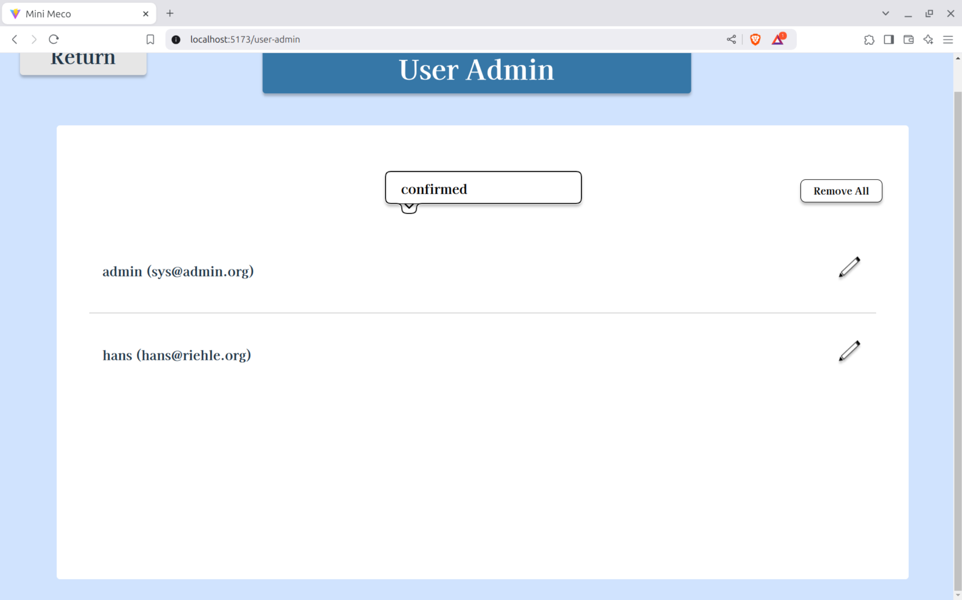
Admin: User Admin
Lists all users, one user per row, with status as one column in a row and an associated filter

Slide 22
Logic of the Course Administration Screen
Three sections: Semester (top) → Course (middle) → Project (bottom)
Each section above provides the context for the section below

Slide 23
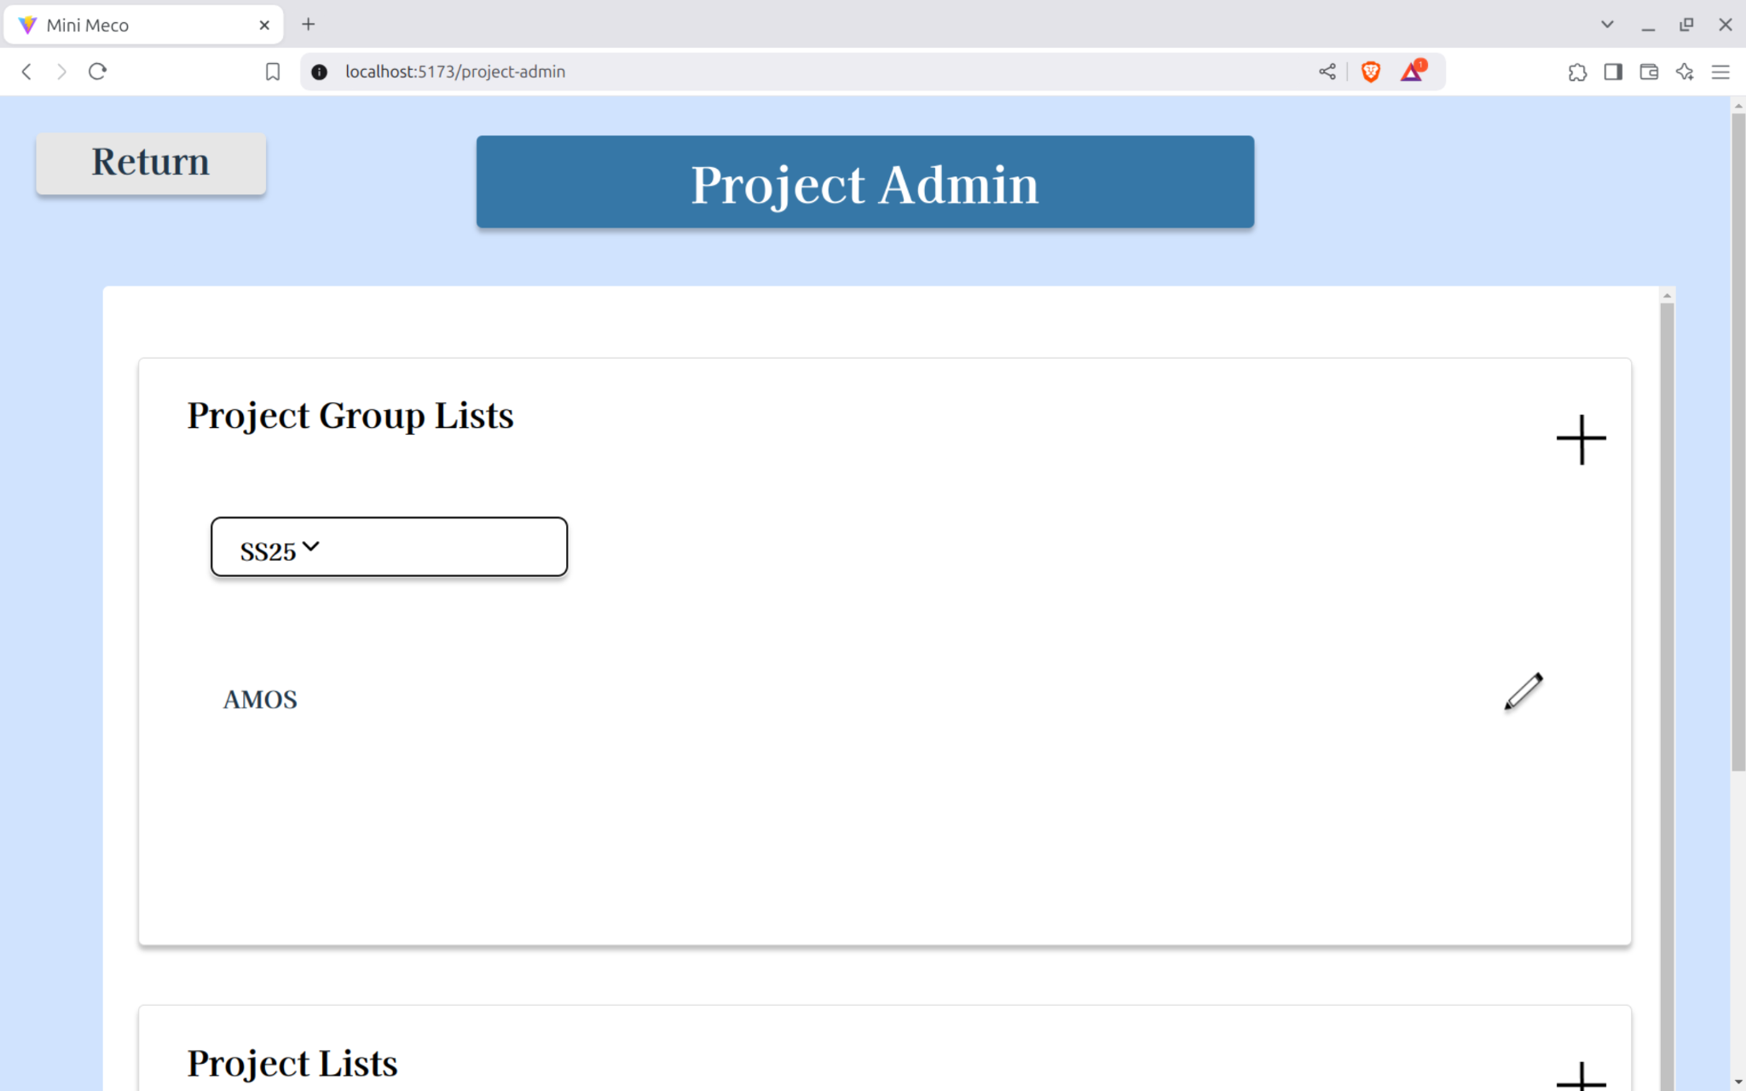
Admin: Project Admin 1
Split into semester section and course section with separate CRUD functions; make sure an object’s id is separate from their name (and that the objects can be renamed i.e. “WS24/25” to “Winter 2024/25”)
Course Administration
Courses

Slide 24
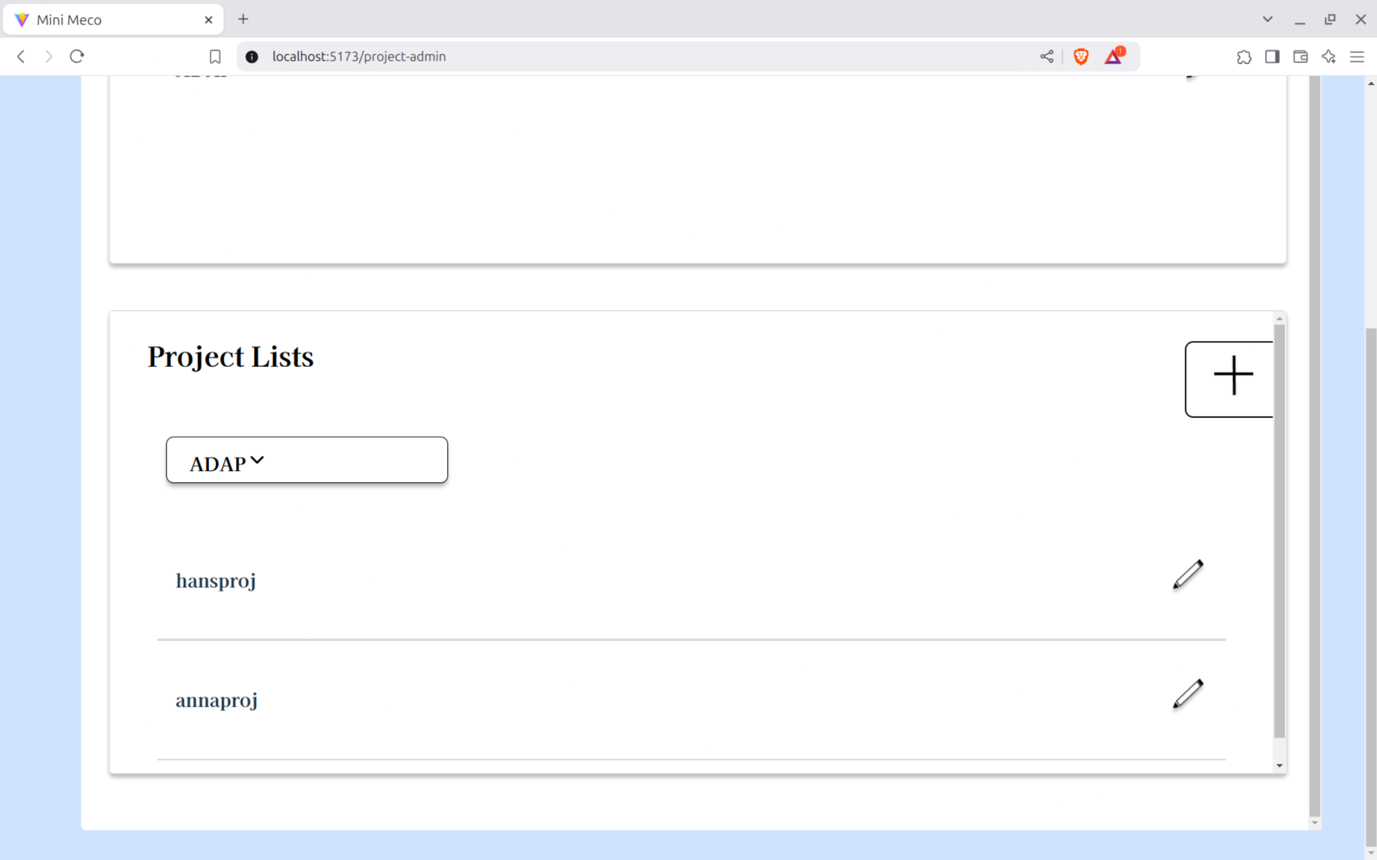
Admin: Project Admin 2
These are admin created projects (AMOS); students can also create projects in another screen and add them to a course (ADAP)
Projects
The edit dialog should allow editing of all project fields; however, only owners can edit, others can only join and view

Slide 25
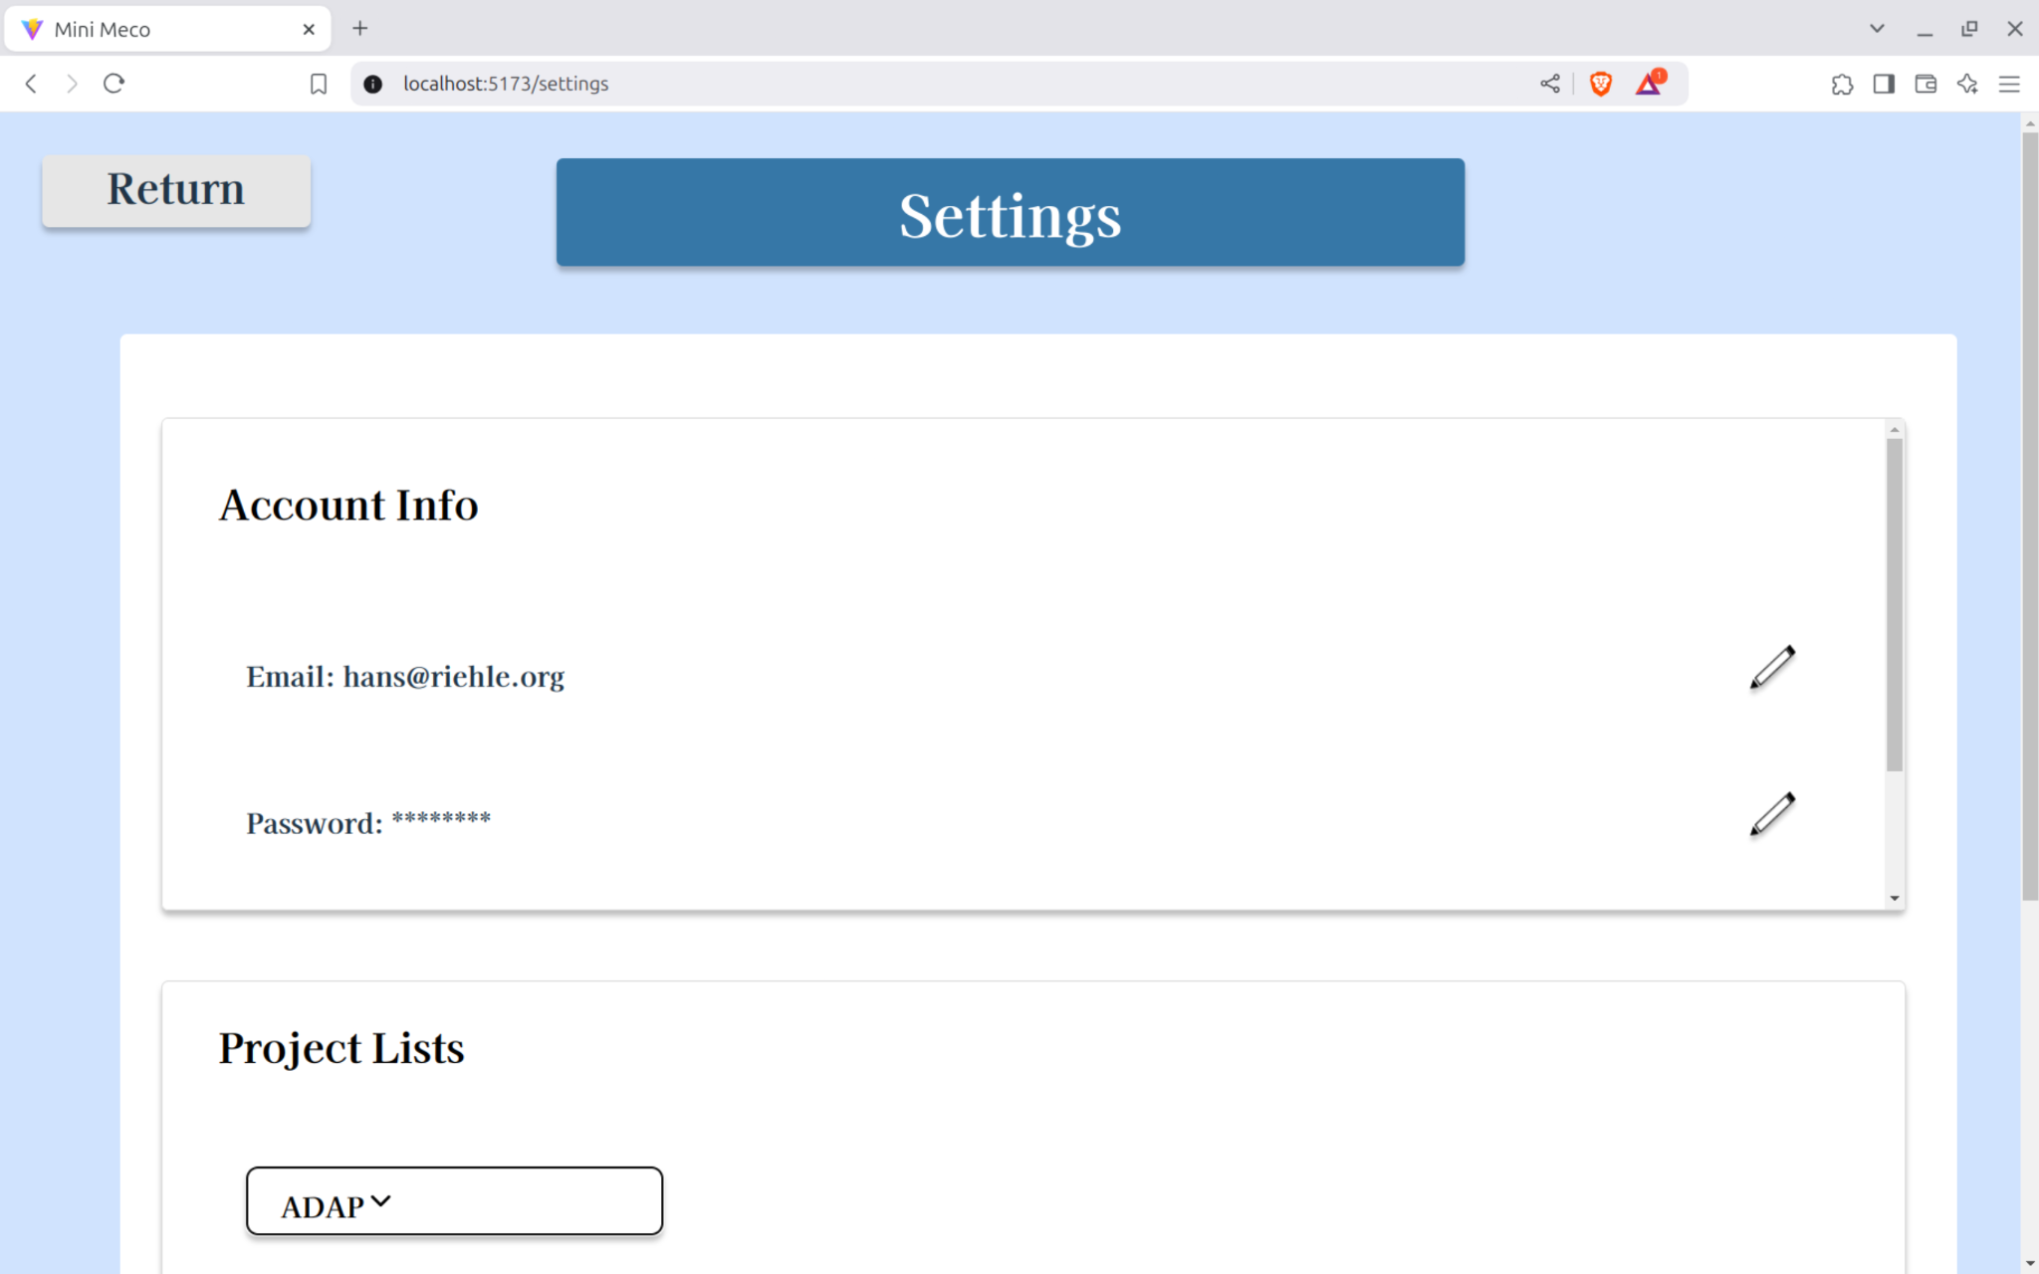
User: Settings
Split into profile (=account info) and courses screens, if possible move profile to usual place (hamburger)
Profile
My Courses

Slide 26
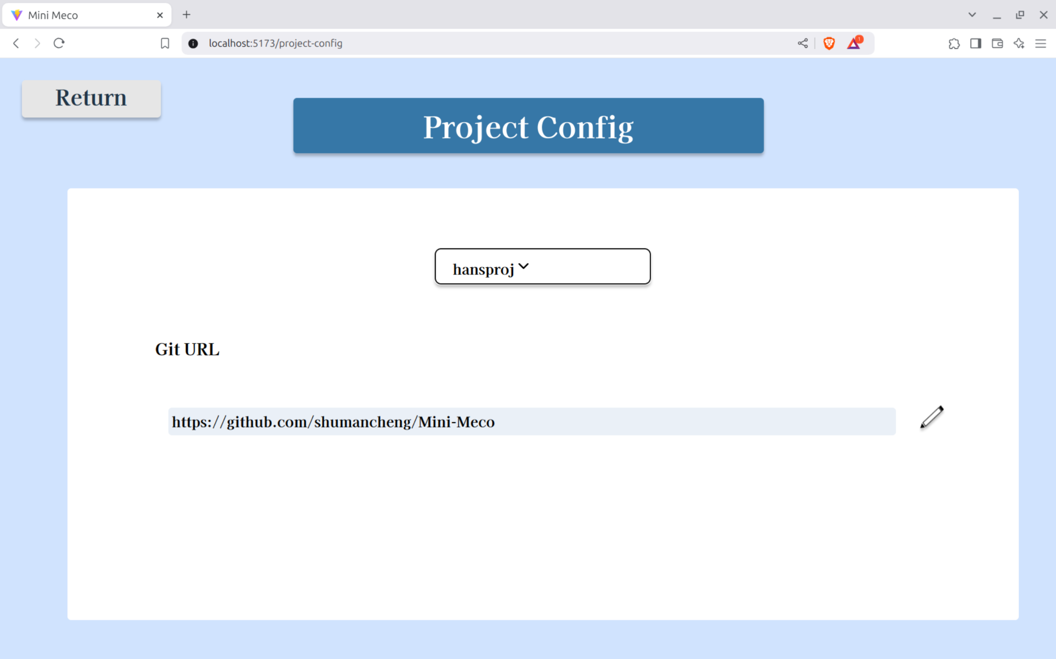
User: Project Config
Project Configuration
Nothing to fix but visuals and CRUD on object; a user can only edit projects they created

Slide 27
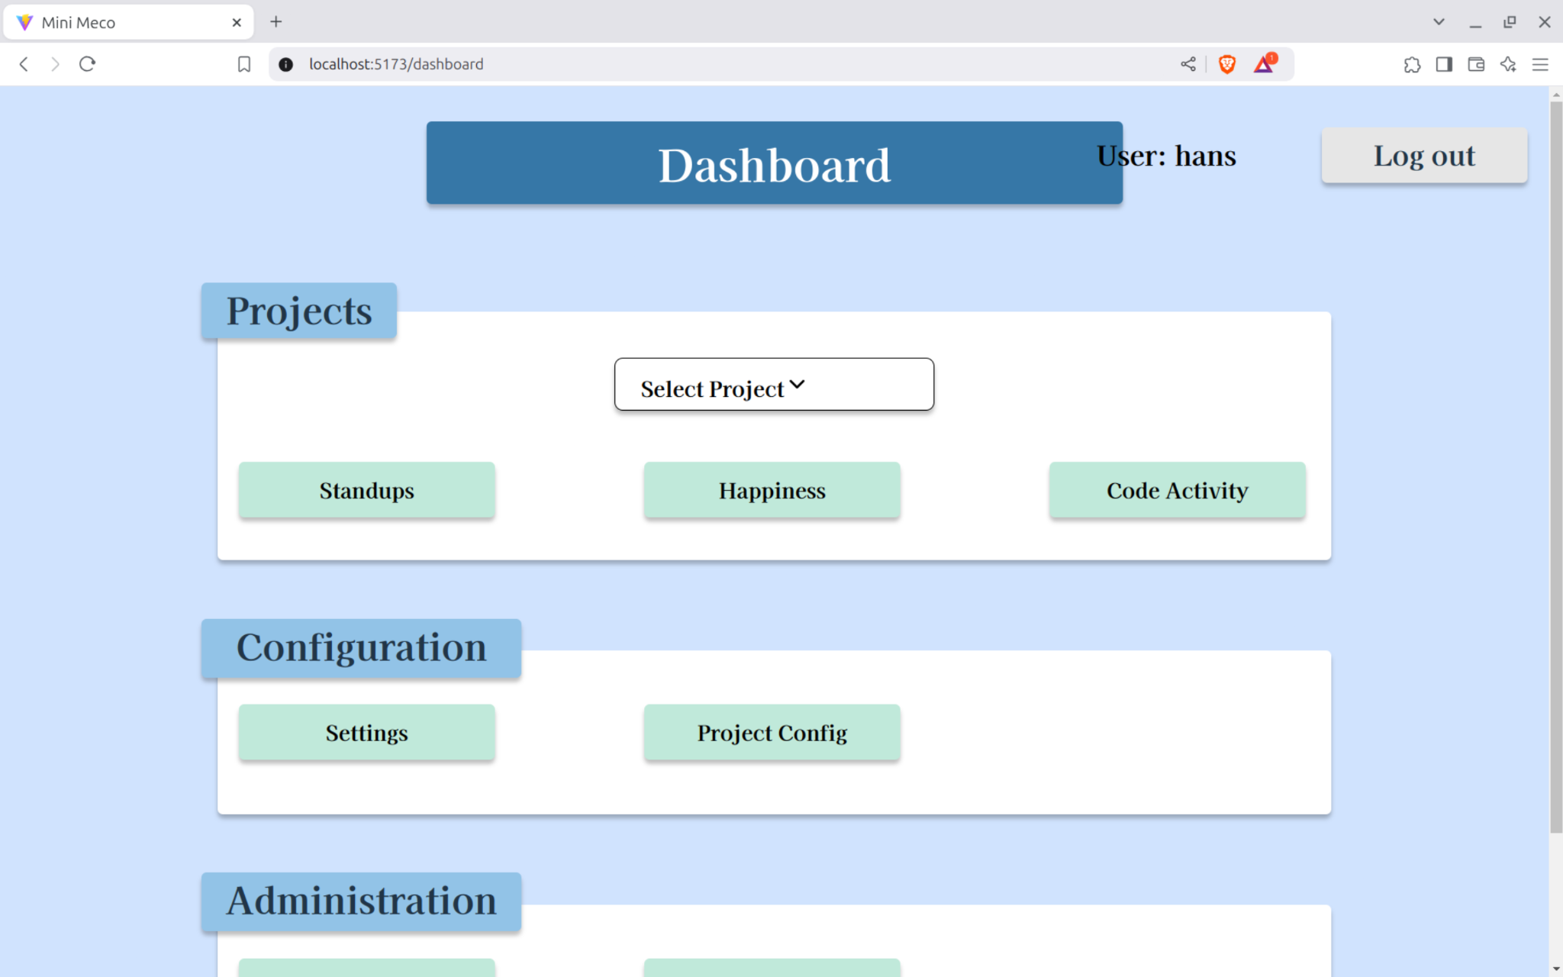
User: Dashboard
Move project choice into respective feature (stand-ups, happiness, etc.)

Slide 28
4. Optional Homework

Slide 29
Mini Meco Extravaganza Homework is Optional
You will not be penalized if you don’t participate
You’ll get extra credit if you participate
Extra credit might lift your grade if you are at a grade boundary
I hope it will be fun; fun as in horror movies can be fun
Or, view this experience as an idea of your first industry job

Slide 30
Mini Meco Extravaganza Timeline
Week | Dates | Topics
9 | Jan-13 to Jan-20 | UI fixes and improvements
10 | Jan-20 to Jan-27 | Domain model (classes)
11 | Jan-27 to Feb-03 | Value types introduction

Slide 31
Mini Meco Extravaganza Timeline
Think about your possible contributions until next week (Dec 16)
Let us know by regular class time if you’d like to contribute
Sign up here https://forms.gle/AD2Q7GT2K8QspcT37
We will assign features using a feature board in time
https://github.com/orgs/riehlegroup/projects/3
You can also grab features yourself

Slide 32
Thank you! Any questions?
dirk.riehle@fau.de – https://oss.cs.fau.de
dirk@riehle.org – https://dirkriehle.com – @dirkriehle

Slide 33
Legal Notices
License
Licensed under the CC BY 4.0 International license
Copyright
© 2012, 2018, 2024 Dirk Riehle, some rights reserved

